Slide 1
AGRICULTURE AND IRRIGATION
Although agriculture had developed earlier in other parts of Tamil Nadu, it was only from the fifth or sixth century that this area was opened up for large scale cultivation.
Forests had to be cleared in some regions.
Land had to be levelled in other areas.
In the delta region embankments had to be built to prevent flooding and canals had to be constructed to carry water to the fields.
Artificial irrigation required in many areas of the Chola empire.
In many areas wells were dug and huge tanks were constructed to collect rainwater.

Slide 2
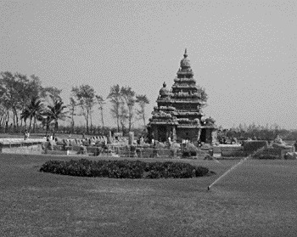
IRRIGATION SYSTEM UNDER THE CHOLAS

Slide 3
ADMINISTRATION UNDER CHOLAS
Settlements of peasants (ur) became prosperous with the spread of irrigation agriculture.
Groups of such villages formed larger units called nadu.
Rich peasants of the Vellala caste exercised considerable control over the affairs of the nadu under the supervision of the central Chola Government.
Chola kings gave some rich landowners titles like muvendavelan , ariayar and entrusted with important offices of the state at the centre.
Brahmanas often received land grants or brahmadeya.
Each brahmadeya was looked after by an assembly or sabha of prominent Brahmanas landholders .

Slide 4
UTTARAMERUR INSCRIPTIONS
The uttaramerur inscpriction provide details of the way in which sabha was organised.
The sabha had separate committees to look after irrigation works, gardens, temples etc.
Names of those eligible to be members of these committees were written on small tickets of palm leaf.
These tickets were put into an earthenware pot, from which a young boy was asked to take out the tickets, one by one for each committee.

